Slide 1
Review of Modern Molecular and Cellular Low Dose Radiation Literature Reveals Need for Paradigm Shifts in Radiation Biology

Slide 2
Overall Aims
Summarize the modern cellular and molecular literature in low-dose radiation (LDR) biology.
Identify molecular paradigms that represent the biological effects of radiation biology in the low-dose range.

Slide 3


METHOD
Low-Dose Radiation
(2012 – 2018)
Inclusion:
□ Total Absorbed Dose <500 mGy
□ Low LET (Linear Energy Transfer)
□ Mammalian Systems
Exclusion:
□ Radiation Therapy Studies
□ Environmental/Occupational Studies
320 Studies
>600 Studies

Slide 4
Data Extraction:
□ radiation type and energy
□ dose, dose-rate, dosing regimen
□ model: species, strain, tissue/cell type, sex
□ analysis: end points, main targets
□ key findings and conclusions
320 Studies
Molecular Endpoints:
DNA Damage/Repair, Genome Instability
Cell Cycle, Differentiation, Senescence
Apoptosis, Necrosis, Autophagy
Reactive Oxygen Species (ROS), Hypoxia
Cellular Metabolism/Energetics
Epigenetics: Methylation, miRNA, Histone
Adaptive Response
Bystander Effects, Intercellular Communication
Immune System
Tumorigenesis, Cancer
Cell Types:
□ Epithelial Cells
□ Fibroblasts
□ Adipocytes
□ Muscle Cells
□ Brain Cells
□ Immune cells
□ Cancer cells
□ Stem cells

Slide 5


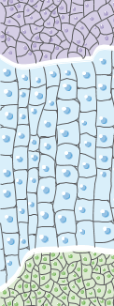

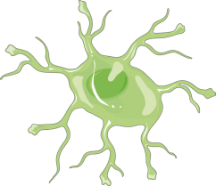
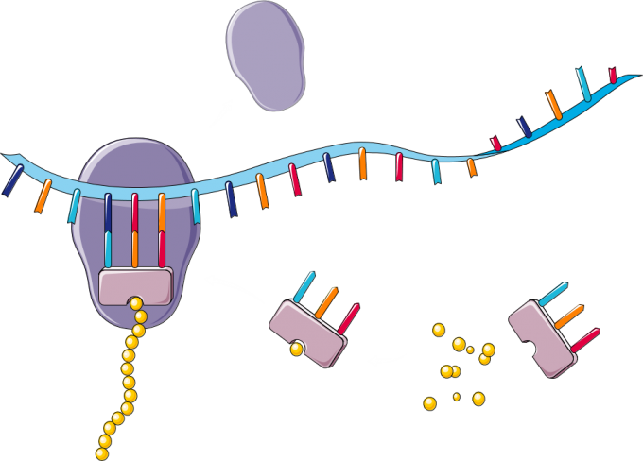




Outline – LDR DEFENSE
Molecules DNA, RNA, Protein
Cells
Tissues
Organs/ Organism
□ DNA Damage Repair
□ Signaling Proteins
□ Epigenetics
□ Cell Cycle Arrest
□ Apoptosis
□ Senescence
□ Bystander Effects
□ Immune System
□ Adaptive Response
□ Disease
□ Cancer
□ Survival

Slide 6
DNA Damage
Radiation mediated DNA damage is linear from 20 mGy to 100 Gy.
Identified using markers of DNA double strand breaks (DSB):
γH2AX, 53BP1, Ser1981-pATM, Rad51, Ku70, and micronuclei formation.
DNA damage between 1 - 20 mGy is cell-type and strain specific.
DNA damage is unnoticeable at very low dose rates.
Despite evidence for linear dose-dependent increase in radiation mediated DNA damage, cancer risks remain unchanged at the low dose (100 mGy) or low dose rates.

Slide 7
DNA Damage: Cancer Risks
□ γ-ray induced neoplastic transformation in CGL1 human hybrid cells (HeLa x skin fibroblast ).
*Adapted from Redpath et al. (2001)

Slide 8
LDR
Macromolecular Changes:
DNA, RNA, Proteins, Epigenetics, Energetics, ROS
DNA
Repair
Cell Cycle
Arrest
Apoptosis
Senescence
Prevents DNA Mutation Accumulation
No Change in Cancer Risk

Slide 9
SSB
LDR
BER
NER
PARP
MMR
DSB
Apoptosis
Repair &
Survival
LDR, DNA Damage Repair & Cell Cycle Arrest
G1
Arrest
Chk2
Cyclin E
Chk1
Cyclin B1
S/G2
Arrest
HDR
LDR
HRR
NHEJ
Repair &
Survival
Ku 70/80
BRCA2
Rad51
Ineffective
repair &
altered
survival
DNA-PKcs
Apoptosis
Repair &
Survival
RPA
Rad52/4
XRCC4
ERCC1
XRCC1
Ligase IV

Slide 10
LDR & Apoptosis
DNA repair systems trigger programmed cell death (apoptosis) when DNA damage is unrepairable.
Apoptosis removes cells with damaged genetic material thereby preventing cancer formation.
Certain cell types such as stem cells have the propensity to initiate apoptosis because they have limited DNA repair capacity.
Other examples: late-stage immune cells (platelets, white blood cells and peripheral blood lymphocytes), mature sperm cells, etc.

Slide 11
LDR
↑ Cyt c
↑ AIF
↑ Procaspases
↑ Complex 3
↑ROS/RNS
↑mitochondrial
swelling
lipid peroxidation
↑ ACAA2
↑ mt-CO2
↑Apoptosis
↑ Cox6a2
↑ Uqcrc1
↑ Ndufa11
↑ Hadh
Mitochondria

Slide 12
Senescence
Prolonged cell cycle arrest due to chronic LDR exposure induces senescence in certain cell-types.
Senescence is an long-standing state of cell cycle block due to unrepaired DNA damage while the cell remains metabolically active.
This often results in cytoskeletal alterations that lead to cellular hypertrophy.
E.g. bone marrow stem cells utilize a senescent phenotype to avoid apoptosis while permitting time for DNA repair systems to repair the damaged nucleotides. This is observed from 40 mGy to 2 Gy.

Slide 13
LDR
Macromolecular Changes
DNA
Repair
Cell Cycle
Arrest
Apoptosis
Senescence
Prevents DNA Mutation Accumulation
ADAPTIVE RESPONSE

Slide 14
LDR & Adaptive Response
↑ CDK4
↑ Cyclin D1
LDR
↑ NFkβ
↑ TNFR1/2
↑ROS/RNS
↑ sp1
Antioxidant
Enzymes
↑ Nrf2
↑ SOD2
P
↑ catalase
↑ GSH
peroxidase
↑ Prdx2
↑ Prdx5
↑ TRXD
□ ↑ antioxidant defense
□ ↑ mitrochondrial homeostasis
□ ↑ aerobic glycolysis
HDR
↑ Radioresistance

Slide 15
Adaptive Mechanisms
Irradiation
↑ Antioxidant Defence Mechanisms
Nrf2
SOD2
Prdx
↑ DNA Repair Pathways
Altered Epigenetic Gene Regulation
DNA Methylation
Histone Modification
Recovery
miRNA
Altered Transcription Factor Expression
NFkβ
Egr1
PPARα
Signaling Molecules
AKT
MAPK
TGFβ
Adaptive
Phenotype
Cyclin D1
AnxA2
TGFBP5
MMPs
BMI1
Survivin
G2 Cell Cycle Arrest

Slide 16
LDR
Macromolecular Changes
DNA
Repair
Cell Cycle
Arrest
Apoptosis
Senescence
Prevents DNA Mutation Accumulation
EPIGENETIC MEMORY
ADAPTIVE RESPONSE

Slide 17
EPIGENETICS
1
TF
XX
Me
Me
Me
Me
TF
Promoter
Gene Expression
Promoter
Gene Expression
Blocked
2
3

Slide 18
Candidate Bystander Biomolecules
BYSTANDER
EFFECT
Unirradiated Cell
LDR
ATP
P2Y receptor
ecDNA
LDR
sCLU
Gap Junctions
TGFβ
LDR
MMPs
Ca
Ca
Ca
cytokines
↑ [Ca²⁺]_{i}
miRNA
Ca
Ca
Ca
Irradiated Cell
Ca
Ca
Ca

Slide 19
LDR Mediates Tissue-Level Defenses Against Cancer via Immune System Modulation
Enhances immune-mediated selective removal of tumorigenic cancer cells.
Suppresses cancer mediated inflammation.
Improves antioxidative capacity and protective defense mechanisms of normal cells thereby limiting tumor formation.
Tumour Growth
Improved Lifespan
Transformation
Frequency

Slide 20
1. LDR enhances immune-mediated selective removal of tumorigenic cancer cells.
Activates Immune System
LDR
↑ dendritic cell
differentiation
↑ NK cell activation
& expansion
Cancerous Tissue
↑ cell surface proteins:
↑CD80, ↑CD86,
↑ MHCI, ↑ MHCII
↑ cytokine secretion:
↑IL-10, ↓IL-12,
↑GM-CSF
↑ antigen uptake
↑ cell surface proteins:
FasL
↑ cytokine secretion:
↑IFNγ, IFNα, ↑ IL-2 , ↑ IL-18,
↑ MIP-1α, ↑ MCP-1, ↑ TNFα
↑ Perforin
↑ antigen uptake
↑ adaptive immune system by improving antigen presentation
↑ removal of tumor cells by initiating the innate immune response
Tumor Removed

Slide 21
2. LDR suppresses cancer inflammation.
DAMPs
VEGF
expression
of NKG2DL
IFN-γ
IL-6
HMGB1
ANGIOGENESIS
Expression
of NKG2D
IL-10
TGF-β
Adapted from Janiak et al. (2017)

Slide 22
3. LDR improves protective defense mechanisms of normal cells thereby limiting tumor formation.
Normal Tissue
Cancerous Tissue
Carcinogen
LDR Adapted Tissue
LDR
↑ Antioxidant System
↑ DNA Repair Systems
↑ Cellular Defences

Slide 23

Example: Lemon et al., 2017
Trp53^{+/-} mice
4 Gy
4 weeks
10 weeks
5 d
Analysis:
□ lifespan
□ latency periods
□ carcinogenesis
endpoints
4 weeks
10 weeks
5 d
4 Gy
Weekly CT scans (10 mGy/scan) for ten consecutive weeks
Conclusions:
□ CT scans increased lifespan by 8% compared to control mice exposed to 4 Gy alone.
□ CT scans increased lymphoma and sarcoma latency.
□ CT scans significantly lowered constitutive and HDR induced levels of apoptosis.

Slide 24
SUMMAY
Hierarchical Levels of Defense Mechanisms Against LDR Perturbations
Organisms
3
IMMUNE RESPONSE
INFLAMMATION
Tissues
Defense
Mechanisms
2
APOPTOSIS
CELL SENESCENCE
Cells
DNA REPAIR
SCAVENGING OF TOXINS
1
Molecules-DNA
Ionizing
Radiation
Atoms
Notes:
Figure 10

Slide 25
The Golden Project
Tharmalingam, S., Sreetharan, S., Brooks, A. L., and Boreham, D. R. (2018) Re-evaluation of the Linear No-threshold (LNT) Model Using New Paradigms and Modern Molecular Studies. Chemico-Biological Interactions (under review).
Zarnke, A. M., Tharmalingam, S., Boreham, D. R., and Brooks, A. L. (2018) BEIR VI Radon: The Rest of the Story. Chemico-Biological Interactions (under review).
Scott, B. R., and Tharmalingam, S. (2018) The LNT Model for Cancer Induction is Not Supported by Radiobiological Data. Chemico-Biological Interactions (under review).
Ricci, P. F., and Tharmalingam, S. (2018) Ionizing Radiations Epidemiology Does Not Support the LNT Model. Chemico-Biological Interactions (under review).

Slide 26
Conclusions: New LDR paradigms
Activates DNA defense mechanisms.
Removes damaged cells.
Initiates G2/M cell cycle arrest and senescence.
Stimulates upstream signaling molecules.
Elicits adaptive memory via epigenetic mechanisms.
Transmits signals to un-irradiated cells (bystander effect).
Enhances immune-mediated removal of tumorigenic cells.
Improves antioxidative capacity of normal cells thereby limiting tumor formation.
Protects against spontaneous neoplastic transformations.

Slide 27




Acknowledgements
Dr. Douglas R. Boreham
Dr. Antone L. Brooks
Dr. Bob Golden, Dr. Bobby R. Scott
Shayenthiran Sreetharan

